Slide 1
CMSC 426 Principles of Computer Security
Introduction to Cryptography (continued)

Slide 2
Last Class We Covered
Introduction to crypto
Definitions
Ciphers
Block ciphers
DES
3DES
AES

Slide 3
Any Questions from Last Time?

Slide 4
Today’s Topics
Block cypher modes
Asymmetric encryption
Diffie-Hellman
RSA
Math (for real this time)

Slide 5
Confusion and Diffusion
Important concepts in cryptography and evaluating effectiveness
Confusion
Each bit of the ciphertext should depend on several parts of the key
Obscures the connection between key and outcome
Diffusion
If a single bit of the plaintext changes, (statistically) about half of the bits in the ciphertext should change

Slide 6
Modes of Operation

Slide 7
Modes of Operation
Block ciphers themselves are only good for encrypting a block
Repeatedly applying a block cipher to larger amounts of data requires a mode of operation
Some modes require an Initialization Vector (IV) to get started
Different modes of operation exist for different purposes
Efficiency
Parallel encrypt and/or decrypt
Encrypting a stream

Slide 8
Notation
EK(P)
Encryption of plaintext P with key K using an arbitrary block cipher
DK(C)
Decryption of cipher C with key K using an arbitrary block cipher
Arbitrary block cipher
For example, DES, 3DES, or AES

Slide 9
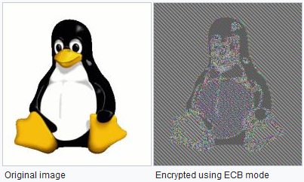
Electronic Codebook Mode (ECB)
Simplest and most naïve mode of operation
Simply encrypts/decrypts each block with the same key
Pros:
En/decryption can be performed in parallel
Cons:
Requires padding of plaintext
Low diffusion
C_{i} = EK(P_{i})
P_{i} = DK(C_{i})
Image taken from https://en.wikipedia.org/wiki/Block_cipher_mode_of_operation

Slide 10
Quick Note: Padding
Padding involves adding garbage/filler to the end of the plaintext so that it perfectly fits within a block size
Downside is not the space “wasted” on the extra text
Rather, padding can allow an adversary to examine and learn things about the plaintext by examining the padded ciphertext
Not something we’ll go into in depth in class
Read about “padding oracle attacks” for more information

Slide 11
Cipher Block Chaining Mode (CBC)
Each block of plaintext is XORed with the previous ciphertext block before being encrypted
Uses an initialization vector for the first plaintext block
Pros:
Much better diffusion
Cons:
Requires padding
Can’t parallelize encryption
But can parallelize decryption – why?
C_{i} = EK(P_{i} ⊕ C_{i-1})
P_{i} = DK(C_{i}) ⊕ C_{i-1}

Slide 12
Cipher Feedback Mode (CFB)
Each block of plaintext is XORed with the previous ciphertext block after the previous ciphertext is re-encrypted
Plaintext never directly “touches” the encryption algorithm
Uses an initialization vector for the first plaintext block
Block cipher is now a “stream cipher”
Uses the block cipher as a “key generator”
Digits can be encrypted one at a time, which means no padding is necessary
Encryption cannot be parallelized
C_{i} = EK(C_{i-1}) ⊕ P_{i}
P_{i} = EK(C_{i-1}) ⊕ C_{i}

Slide 13
Counter Mode (CTR)
Also works as a stream cipher
Requires a pseudo-random seed, S, to function
For each successive en/decrypt, the seed “counts” up by one
Pros:
Encryption can be parallelized, as seed simply counts up
Decryption can be parallelized as well
Plaintext does not need to be padded
Cons:
???
C_{i} = EK(S + i -1) ⊕ P_{i}
P_{i} = EK(S + i -1) ⊕ C_{i}

Slide 14
Comparison of Modes of Operation
 | Parallel Encrypt | Parallel Decrypt | Padding Required | Stream Cipher | Repeats in Cipher¹
ECB | ✔ | ✔ | ✔ |  | ✔
CBC |  | ✔ | ✔
CFB |  | ✔ |  | ✔
CTR | ✔ | ✔ |  | ✔
¹ Encrypting structured or repeating plaintext results in repeating cipher blocks.

Slide 15
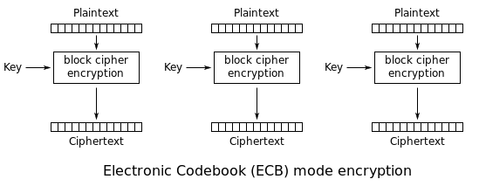
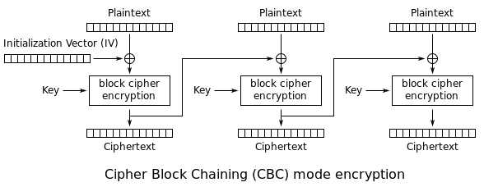
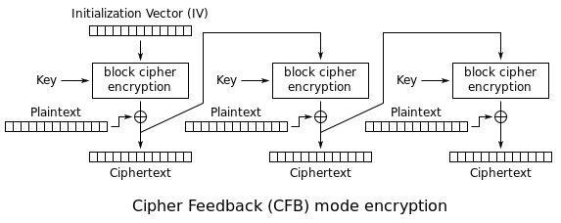
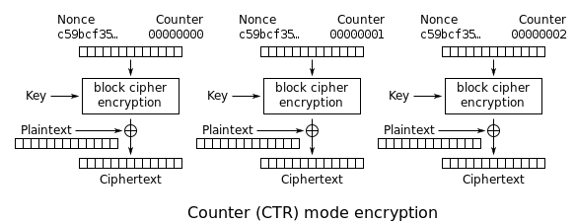
Enc. Algorithms of Modes of Operation
Images taken from https://en.wikipedia.org/wiki/Block_cipher_mode_of_operation

Slide 16
Diffie-Hellman

Slide 17
Shortcomings of Symmetric Encryption
Symmetric key must remain secret to be secure
But how do you communicate what the secret key is?
Without already having a secret key?
???
You can’t!
Need some way to share keys over an unsecured channel

Slide 18
Diffie-Hellman Key Exchange
Named after Whitfield Diffie and Martin Hellman
It is a way for two parties to
Use insecure communication to
Agree on a cryptographic key
Without anyone else being able to figure out what it is
Neither party “chooses” the key, but that doesn’t matter
They just need the same one
How to achieve this?
Math!

Slide 19
Basic Diffie-Hellman Algorithm
Choose two non-secret values p and g
p is prime
g is generator, a primitive root modulo p (don’t worry about this right now!)
Each party
Chooses an integer Y in the range 1 to p - 1 (inclusive)
Calculates y = g^{Y} % p and transmit y across the clear channel
Use the other party’s transmitted integer (x) to calculate K = x^{Y} % p
Both parties now have the same value K, for a symmetric key

Slide 20
Example Diffie-Hellman Algorithm
Alice and Bob agree to use p = 37 and g = 11
Normally they would use large numbers, but this is an example
Alice chooses the integer A = 2, Bob chooses B = 9
a = g^{A} % p a = 11² % 37 a = 10
b = g^{B} % p b = 11⁹ % 37 b = 36
Over the clear channel, Alice transmits 10 and Bob transmits 36
Each now calculates the key K
Alice: K = b^{A} % p K = 36² % 37 K = 1
Bob: K = a^{B} % p K = 10⁹ % 37 K = 1

Slide 21
Diffie-Hellman: The Math
Alice calculates a = g^{A} % p
Bob calculates b = g^{B} % p
They transmit these values of a and b to each other, then…
Alice calculates K = b^{A} % p same thing as (g^{B} % p)^{A} % p
Bob calculates K = a^{B} % p same thing as (g^{A} % p)^{B} % p
Both of which simplify to g^{AB} % p
(Because ~*~math~*~)

Slide 22
Diffie-Hellman Security
Only p, g, a, and b are transmitted in the clear
So any attacker could have those
But to calculate K, they also need either A or B
Which they could solve for with the formula log_{g} B % p
But this is really hard to do when p is 600 digits long
(For now – if this changes, we’re all in deep trouble.)
Private keys (A and B) should also be large numbers
Makes them difficult to calculate for an attacker, or even for the other legitimate person in the communication

Slide 23
RSA (not a real acronym)

Slide 24
RSA Overview
RSA stands for Rivest, Shamir, and Adleman, its inventors
Is not necessarily a method for key exchange
Is a form of asymmetric encryption
Uses two separate keys: public and private
Public key is available to anyone and everyone
Private key must be kept secret

Slide 25
RSA Key Generation Algorithm
Pick two secret prime numbers, p and q
With those values, calculate n = p * q
Choose a valid public exponent e
Software today uses 65537 (0x10001) to make calculations faster
A valid e is not a factor of n, and must be less than (p-1)*(q-1) (~*~math~*~)
Calculate a private exponent d
Such that e is congruent to d % (p -1) * (q -1) (more ~*~math~*~)
Public key components are n and e
Private key components are n and d (normally save p and q too)

Slide 26
Using RSA Keys
Encryption
The plaintext P is converted into an integer m
(Don’t worry about this for now)
C = m^{e} % n (remember, e and n were our public key components)
Decryption
m = C^{d} % n (remember, d and n were our private key components)
Mathematical proof
Outside of the scope of this class (number theory, etc.)
Read the paper if you’re really interested

Slide 27
RSA Example: Key Generation
Key generation:
Choose p = 43 and q = 59
Calculate n = p * q n = 43 * 59 n = 2537
Choose e = 67
Calculate d = 1927
Public key: n = 2537, e = 67
Private key: n = 2537, d = 1927

Slide 28
RSA Example: Encryption/Decryption
Now, someone wants to send you a message m = 42
To encrypt it, they use your public key: n = 2537, e = 67
C = m^{e} % n C = 42⁶⁷ % 2537 C = 1332
This ciphertext of 1332 is sent over a clear channel
After receiving the message 1332, you want to read it
To decrypt, you’ll use your private key: n = 2537, d = 1927
m = C^{d} % n m = 1332¹⁹²⁷ % 2537 m = 42

Slide 29
RSA Security
An attacker has access to only n and e
They need access to d to have a complete private key
If they could factor p and q out of n, they could calculate d
Fortunately, calculating the large primes that are the only factors for a large number is hard
The larger the primes, the harder it is to factor
Fun fact: the largest known prime is 2^{77,232,917} − 1
It has 23,249,425 digits

Slide 30
RSA: Digital Signatures
Encryption and decryption are inverses of each other
If something is encrypted with the private key, it can be decrypted with the public key
What does this allow us to do?
State “only this person could have encrypted this”
This is called a digital signature, and is meant to prove the message came from a specific individual
This alone does not guarantee any confidentiality for the contents of the message

Slide 31
(Pseudo)-Random Number Generation
rand() is not an acceptable (pseudo) random number generator for anything that has an actual purpose
If you want something statistically viable, you need to use an actually good pseudorandom number generator (PRNG)
If you’re going to use the numbers for security-related purposes, use a cryptographically secure pseudorandom number generator (CSPRNG)
If you don’t know if it’s a CSPRNG, it probably isn’t

Slide 32
Quantum Computing
If a sufficiently large quantum computer is ever built:
RSA and Diffie-Hellman are completely broken by an algorithm called Shor’s algorithm
The bit length of symmetric ciphers is effectively halved
If it would previously require 2¹²⁸ computations to crack something, it would only require 2⁶⁴ quantum computations

Slide 33
Announcements
Lab 2 and Homework 2 are due Wednesday night
Paper 2&3 are due next Wednesday
Exams are graded and available for pickup

